Slide 1
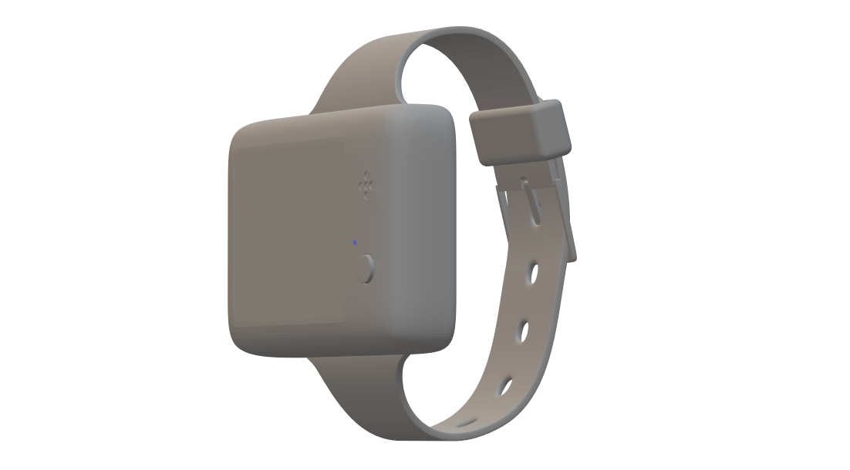
ALZHEIMER’S VIRTUAL ASSISTANT
Submitted by:
4 BIT CODE

Slide 2
AGENDA
Executive Summary
Solution Brief
Components used
Implementation details
Circuit implementation
Constraints
About Us

Slide 3
Executive Summary
Alzheimer's disease is a progressive disorder that causes brain cells to degenerate and die. It is the most common form of dementia. Worldwide, around 50 million people have dementia, and there are nearly 10 million new cases every year. In India, more than 1 million cases are reported per year. This disease is mostly found in persons aged 65 or above. The patients affected by this disease should be treated with utmost care but lack of attention may lead to unexpected deaths.
To tackle these situations and to help the patients and caretakers, we have come with an idea of ALZHEIMER’S VIRTUAL ASSISTANT. This is a wearable device which reminds the patient about the tasks like medications, exercises and other activities. It also alerts caretakers in Emergency situations and will also monitor the patients. In addition to this, we have incorporated health monitoring parameters so that it would be a complete medical aid for the patients.

Slide 4
Solution Brief
We have designed this system with 2 parts:
A Wearable device(as in like a watch) for the patients.
An app for caretakers so that they could monitor the patient parameters through a mobile phone.
Features incorporated in this device:
Fall detection – It will alert the caretaker through the mobile app when patient falls down.
Pressure Sensing unit
Temperature Sensing unit – measures temperature of the patient
Reminders about medications, exercises and daily activities
Alert caretakers in emergency situations( patients could alert caretakers themselves in such situations)
Date and time
Heart rate sensor and oxygen saturation level monitoring
Location detection – indicates the live location of the patient

Slide 5
COMPONENTS USED
HARDWARE COMPONENTS:
Arduino MKR1000
Infineon Sensor Hub nano
HC-05 Bluetooth module
Nokia 5110 LCD display
Buzzer and LED
Heart rate sensor
Blood oxygen saturation sensor
Apps and online services
SOFTWARE COMPONENTS:
Arduino IDE
Blynk IOT platform

Slide 6
Implementation Details
This wearable device mainly works on the board Arduino MKR1000 and a Bluetooth module HC-05 is connected with Arduino board to communicate with Infineon’s sensor hub Nano.
The device mainly working on Master-Slave asymmetrical configuration which Arduino board works as master.
This circuitry is connected with Blynk IOT platform so that the device can communicate with caretaker’s smart phone with Blynk app.
Infineon’s sensor hub Nano is used to measure pressure, temperature and altitude.
Configuration is done in two stages
First stage is Bluetooth module configuration using Arduino board.
Arduino board configuration.

Slide 7
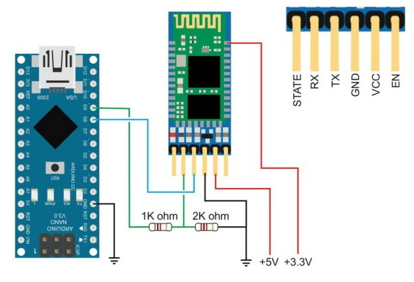
CIRCUIT IMPLEMENTATION

Slide 8
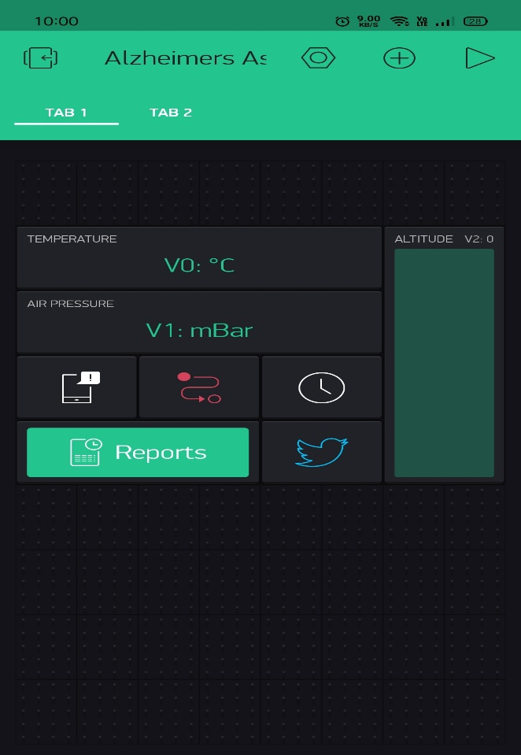
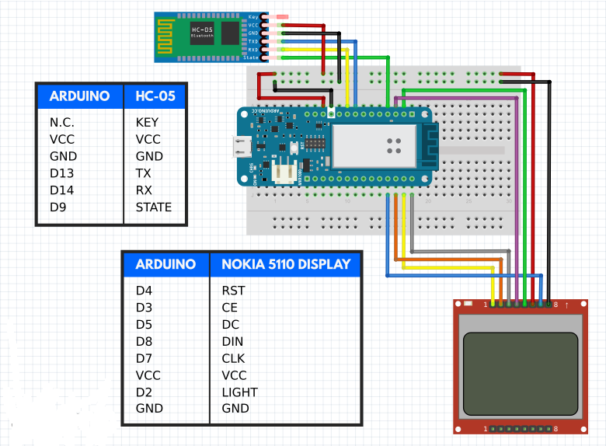
CIRCUIT IMPLEMENTATION
Blynk app screeenshot

Slide 9
CONSTRAINTS
In this current pandemic situation it was not easy to find hardware kit required for our specification. We couldn’t also find any simulation software for the same so that we are unable to demonstrate it’s working.
Due to time constraint, some of the features that we have mentioned in this project will be implemented in its future developmental stage.

Slide 10
ABOUT US
Jibi Antony – Team Leader
Electronics and Biomedical Engineering
V Anandhu
Electronics and Biomedical Engineering
Binusree M B
Electronics and Biomedical Engineering
Swathi Krishna M
Electronics and Biomedical Engineering

Slide 11
THANKYOU

